Slide 1
SYE3209: Software Construction
Lecture 03 (BSCS II & III)
Topic: Clean Code Principles in Software Construction
Simon Fred Lubambo
Department of Computing & Technology
Faculty of Engineering, Design & Technology

Slide 2
Lecture Overview
Introduction: Why Clean Code Matters
What Is Clean Code?
Why Clean Code Is a Core Part of Software Construction
Industry Reality: Clean Code at Scale
Readability: Code Is Written for Humans

Slide 3
Introduction: Why Clean Code Matters
In professional software development, code is read far more often than it is written. While a programmer may write a piece of code once, that same code may be read, reviewed, debugged, extended, or refactored hundreds of times by different people over several years.
Clean code is therefore not a matter of personal style; it is a professional responsibility.
“Any fool can write code that a computer can understand.
Good programmers write code that humans can understand.”
— Martin Fowler.

Slide 4
What Is Clean Code?
Clean code refers to source code that is:
Easy to read
Easy to understand
Easy to modify
Easy to test
Easy to maintain over time
Clean code communicates intent clearly, minimizes surprises, and reduces the cognitive effort required to
understand how a system works.

Slide 5
Why Clean Code Is a Core Part of Software Construction
Clean code is central to software construction because software systems:
Are built by teams, not individuals
Evolve continuously
Must be maintained long after the original developers leave
Are often business-critical
In poorly constructed systems:
Small changes cause unexpected failures
Developers fear touching existing code
Bugs increase as the system grows
Technical debt accumulates rapidly

Slide 6
Industry Reality: Clean Code at Scale
Google maintains billions of lines of code across thousands of repositories. Engineers are often required to modify code written by someone they have never met.
To manage this:
Code readability is enforced as a policy
Code reviews are mandatory
Naming, structure, and clarity are prioritized over cleverness
At Google, a change may be rejected not because it is incorrect, but because it is hard to read or understand.

Slide 7
Industry Reality: Clean Code at Scale
Microsoft’s long-lived products (e.g., operating systems, enterprise platforms) must remain maintainable for decades.
Clean code enables:
New engineers to onboard quickly
Legacy systems to evolve
Bugs to be fixed safely without introducing new ones
Many system failures historically traced back to poorly structured, tightly coupled code, not lack of technical skill.

Slide 8
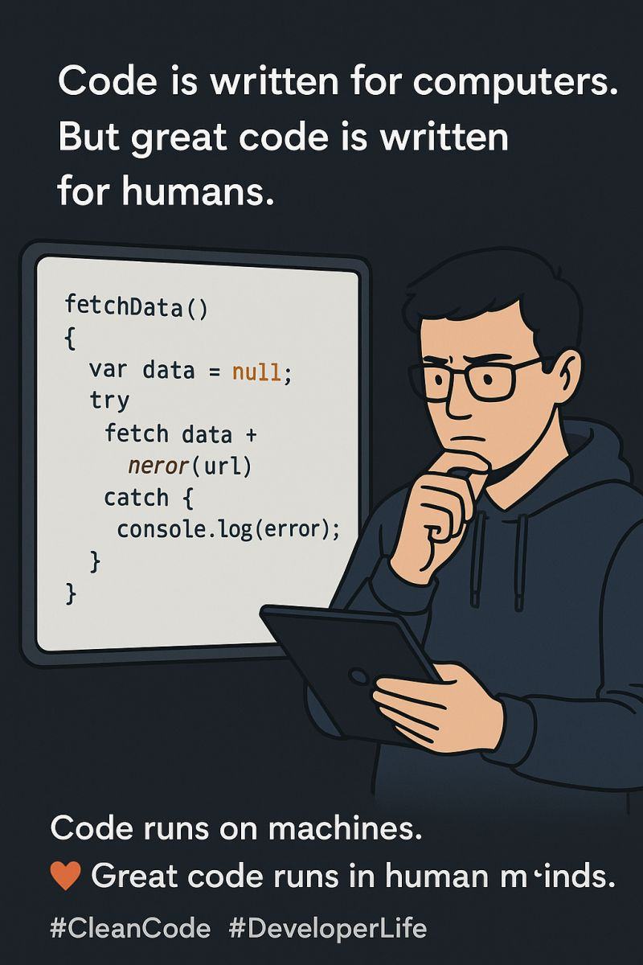
Readability: Code Is Written for Humans
Readable code:
Uses meaningful names
Has a clear structure
Avoids unnecessary complexity
Expresses intent directly
Unreadable code:
Requires constant comments to explain it
Relies on mental decoding
Slows down development
Increases error rates

Slide 9
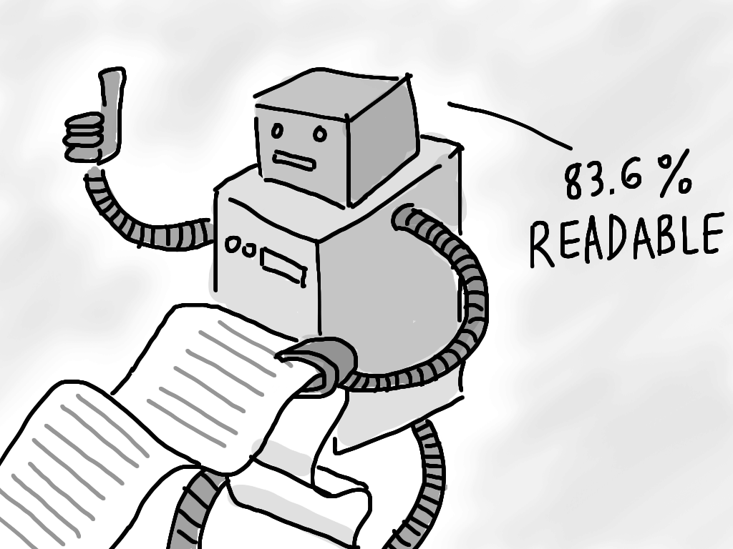
Example
Poor readability:
Single-letter variables
Long, nested logic
No clear separation of responsibilities
High readability:
Descriptive names
Small, focused functions
Logical flow
Minimal mental overhead

Slide 10
Naming: One of the Hardest Problems in Software
Good names:
Reveal intent
Reduce the need for comments
Make code self-documenting
Bad names:
Hide meaning
Increase misunderstanding
Cause bugs during maintenance

Slide 11
Real-World Example
Consider a variable named x.
What does x represent?
Why does it exist?
What unit or meaning does it carry?
A descriptive name (e.g., totalInvoiceAmount) removes ambiguity and reduces errors.

Slide 12
Functions Should Do One Thing
Functions that do many things:
Are harder to test
Are harder to reuse
Are harder to debug
Are more likely to break during changes
In contrast, small, focused functions:
Are easier to reason about
Encourage reuse
Support testing
Improve maintainability

Slide 13
Code Smells: Warning Signs in Software
A code smell is an indication that something may be wrong with the structure or design of the code.
Code smells are not necessarily bugs, but they increase the risk of bugs.
Common Code Smells:
Very long functions or methods
Classes with too many responsibilities
Repeated code (duplication)
Excessive use of comments to explain logic
Deeply nested conditionals
Hard-coded values

Slide 14
Industry Insight
Large companies invest heavily in:
Static analysis tools
Code review processes
Automated checks
These are not to punish developers, but to detect code smells early,
before they grow into major maintenance problems.

Slide 15
Comments vs Self-Documenting Code
Comments are useful when:
Explaining why a decision was made
Clarifying non-obvious business rules
Documenting public interfaces
Comments are not a substitute for poor code..

Slide 16
Clean Code Philosophy
If code requires extensive comments to explain what it does, the code itself likely needs improvement.
Good code:
Explains itself through structure and naming
Uses comments sparingly and purposefully

Slide 17
Clean Code and Maintainability
Maintainable software is software that:
New developers can quickly understand
Can be modified without fear
Supports new requirements with minimal disruption
Clean code directly supports maintainability by:
Reducing cognitive load
Localizing changes
Minimizing side effects

Slide 18
Real-World Fact
Studies in software engineering consistently show that:
Poor code structure increases defect rates
Teams with clean code practices deliver features faster
Technical debt slows innovation and increases costs

Slide 19
Clean Code Is a Team Discipline
Clean code is not achieved by:
One brilliant developer
Writing clever code
Working alone
It is achieved through:
Shared standards
Code reviews
Continuous refactoring
Team agreement on quality

Slide 20
Clean Code and Professional Responsibility
As future software engineers, students must understand that:
Other people will depend on their code
Poor code quality has real consequences
Software failures can affect businesses, institutions, and lives
Writing clean code is part of ethical software construction.

Slide 21
Relationship to the Course
This week’s concepts connect directly to:
Refactoring (Week 8)
Testing (Week 7)
Modular design (Week 5)
Team development (Week 10)
Clean code is not a one-time activity;
it is a continuous practice throughout the software lifecycle.

Slide 22
Key Takeaways
Clean code is essential for maintainable software
Readability is more important than cleverness
Naming and structure greatly affect understanding
Code smells signal deeper design problems
Clean code is a team responsibility
Professional software construction demands clarity

